Slide 1

MODULE 4 DATA COLLECTION INTERPRETATION AND REPORTING

Slide 2

DATA COLLECTION
The process of collecting data from the samples.
It begins after defining the research problem & research design.
TYPES OF DATA
Primary data : The data collected fresh and for the first time. The data would be original.
Secondary data: The data that has already been collected by someone and which have already been passed through the statistical process.
Notes:
The methods of collecting primary and secondary data differ since primary data are to be originally collected, while in case of secondary data the nature of data collection work is merely that of compilation.

Slide 3
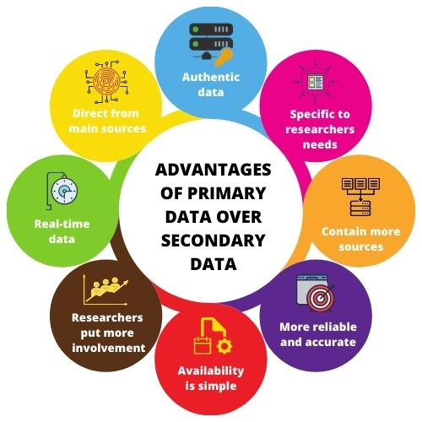
PRIMARY VS SECONDARY DATA
PRIMARY DATA | SECONDARY DATA
Real time data | Past Data
Specific to the researchers needs. | Not specific to the researchers needs.
Expensive | Low cost or Free
High level of control on data quality. | Lacks control over data quality.
More time consuming | Less time consuming
More capable to solve specific problem. | Less capable to solve a specific problem.
Owner of data, data can be hidden from competitors. | Competitors also have access to data.

Slide 4
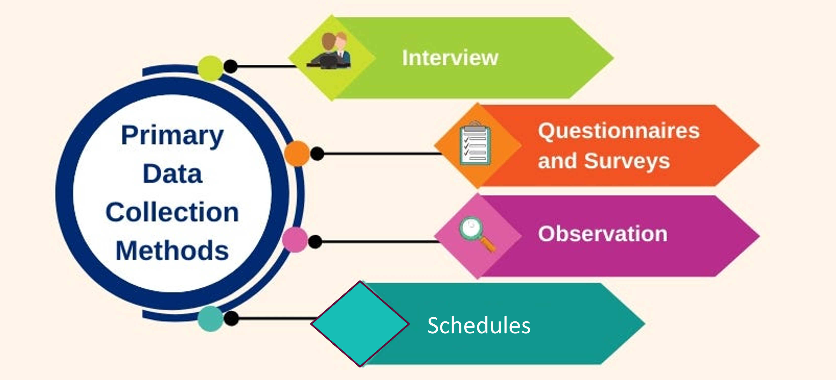

Slide 5

OBSERVATION METHOD
The information is collected by investigator’s own direct observation.
The Respondent is not involved in the process.
Observation becomes a scientific tool, when it serves a formulated research purpose.
Thinks to keep in mind while planning an observation.
Need to be planned systematically.
What is to be observed?
How the observations should be recorded?
How the accuracy of observation can be ensured?
Notes:
It must be systematically planned and recorded .
In a way we all observe things around us, but this sort of observation is not scientific observation.

Slide 6
STRUCTURED VS UNSTRUCTURED OBSERVATION
STRUCTURED OBSERVATION
Also called Systematic Observation.
The researcher specifies in detail what is to be observed and how the measurements are to be recorded.
It defines all the units of observation in advance.
E.g. An auditor performing inventory analysis in a store.
UNSTRUCTURED OBSERVATION
The units of observation are not predefined.
It monitors all the aspects of the phenomenon that seems relevant to the problem in hand.
E.g. Observing children playing with new toys.

Slide 7
OBSERVATION METHOD PROS AND CONS
MERITS | DEMERITS
Subjective bias is eliminated if done accurately. | It is an expensive method.
Not complicated by the past behavior or future intentions. | The information provided by this method is very limited
It is independent of respondent's willingness to respond. | Unforeseen factors may interfere with the observational task.
Relatively less demanding of active cooperation from respondents. | People are rarely accessible to direct observation

Slide 8



BASED ON OBSERVER PARTICIPATION
PARTICIPANT OBSERVATION : If the observer observes by making himself, a member of the group he is observing.
NON-PARTICIPANT OBSERVATION : The observer observes without any attempt on his part to experience through participation what others feel.
DISGUISED OBSERVATION: The observer is observing in such a manner that his presence may be unknown to the people he is observing.
Notes:
so that he can experience what the members of the group experience

Slide 9
MERITS & DEMERITS OF PARTICIPANT OBSERVATION
MERITS | DEMERITS
Researcher is enabled to record the natural behavior of the group directly. | Observers' presence may create artificial situation.
Researcher can even verify the truth of statements made by informants. | Time consuming and challenging to collect data while participating.
Gets more of direct and information. Gather more information easily. | May lose the objectivity to the extent he participates emotionally.

Slide 10
BASED ON OBSERVATION SETTING
CONTROLLED OBSERVATION: Observation takes place according to definite pre-arranged plans.
It takes place in a laboratory or under controlled conditions.
We use mechanical instruments as aids to accuracy and standardization.
These observations supply formalized data.
NON-CONTROLLED OBSERVATION: The observation takes place in the natural setting.
It gives a spontaneous picture of life and persons.
It tends to supply naturalness and completeness of behavior.
Allows sufficient time for observing.

Slide 11


PERSONAL INTERVIEW
TELEPHONIC INTERVIEW

Slide 12

INTERVIEW METHOD - PERSONAL
PERSONAL INTERVIEW : It is a face-to-face meeting or two-way communication between the interviewer and the interviewee.
BASIC PRINCIPLES OF INTERVIEWING
Interviewers should be carefully selected and trained.
Interviewer need to be honest, sincere, impartial.
Interviewer should have good practical experience.
Occasional field checks.
Appropriate actions, if the respondents refuse to cooperate.
Should create friendly atmosphere of trust and confidence.
The questions must be asked properly and intelligently.
The responses must be recorded accurately and completely.
The interviewer must answer legitimate questions by the respondent.
The interviewer must clear the doubts by the respondent.
The interviewer should not show surprise or disapproval of the responses.
Should discouraging irrelevant conversation.
Notes:
Occasional field checks .
to ensure that interviewers are not deviating from topic
Appropriate actions, if the respondents refuse to cooperate. Or is not available.

Slide 13

PERSONAL INTERVIEW TYPES
DIRECT PERSONAL INVESTIGATION
The interviewer collects the information personally from the sources concerned by meeting in person.
It involves spot enquiry.
Provides the investigator an opportunity to explain the study and objectives.
The investigator can also ask the respondent to expand the answers essential for the investigation.
The respondents might also provide supplementary information to the interviewer.
INDIRECT ORAL INVESTIGATION
The interviewer must approach a third person who has knowledge about the problem under investigation.
It is used when the area of investigation is large.
Used when respondents feel reluctant in parting information known to them.
The investigator prepares a list of questions related to the investigation, and then asks from different persons and records their answers.
The person from whom these questions are asked is known as a witness.
Notes:
For successful implementation of the interview method,

Slide 14
PERSONAL INTERVIEW TYPES
STRUCTURED INTERVIEW
Uses a set of predetermined questions & highly standardized techniques of recording.
Here the interviewer follows a rigid procedure of, asking questions.
Interviewer cannot skip or alter the sequence of questions.
UNSTRUCTURED INTERVIEWS
They follow a more flexible approach with no pre-determined questions and standardized recording techniques.
The interviewer has the freedom to ask, supplementary questions or omit certain questions if required.
He may even change the sequence of questions.
Its needs deep knowledge and greater skill on the part of the interviewer.

Slide 15
PERSONAL INTERVIEW TYPES
FOCUSSED INTERVIEW
It focuses on the given experience of the respondent and its effects.
Interviewer has the freedom to decide the sequence of questions.
He also has the freedom to explore reasons and motives behind the responses.
The interview aims to confine the respondent to a discussion that is of concern.
CLINICAL INTERVIEW
It is concerned with broad underlying feelings wrt to individual’s life experience.
The method of obtaining information is left to the interviewer’s discretion.
NON-DIRECTIVE INTERVIEW
The interviewer’s role is to encourage the respondent to talk on the given topic.
There involves minimum questioning.

Slide 16
PERSONAL INTERVIEW
MERITS | DEMERITS
Can obtain more information in greater depth. | It is a very expensive method, specially when the sample is very large.
Offers greater flexibility, the questions can be restructured as required. | Possibility of the bias by the interviewer as well as the respondent.
The interviewer can collect supplementary information about the respondent’s personal characteristics. | Relatively more-time-consuming, specially when the sample is large.
Interviewer can control which persons will answer the questions. | Certain types of respondents (high profile), may not be easily approachable.

Slide 17

TELEPHONIC INTERVIEW
This method of collecting information involves contacting respondents over telephone.
It is not a very widely used method but plays important part in industrial surveys.

Slide 18
TELEPHONIC INTERVIEW
MERITS | DEMERITS
It is more flexible, faster, cheaper in comparison to other method. | Little time is given to respondents for answers.
Recall is easy, callbacks are simple and economical. | Interview period is not likely to exceed five minutes in most cases.
There is a higher rate of response, and respondents are easy to access. | Surveys are restricted to respondents who have telephone facilities.
Interviewer can explain requirements more easily, wider distribution of sample is possible. | Possibility of the bias of the interviewer is relatively more.
No field staff is required to recorded the responses. | Questions must be short and to the point.

Slide 19

QUESTIONNAIR METHOD OF DATA COLLECTION

Slide 20

DATA COLLECTION - QUESTIONNAIRES
Used for big enquiries.
A questionnaire is sent to the respondents with a request to answer and return.
A questionnaire consists of several questions printed or typed.
The respondents must answer the questions on their own.
Quite often questionnaire is considered as the heart of a survey operation.
It is used by private individuals, research workers, private and public organizations and governments.

Slide 21
QUESTIONNAIR METHOD
MERITS | DEMERITS
Low cost even when the universe is large and is widely spread geographically. | Low rate of return of the duly filled in questionnaires. It can be used only when respondents are cooperating.
It is free from the bias of the interviewer, and answers are in respondents own words. | The control over questionnaire may be lost once it is sent.
Respondents have adequate time to give out the answers. | Possibility of ambiguous replies, Omission of replies altogether, leads to bias.
Respondents, who are not easily approachable, can be reached conveniently. | This method of data collection is the slowest of all.
Large samples can be made use of and thus the results can be made more dependable and reliable | It is difficult to know whether respondents are truly representative.

Slide 22
STRUCTURED QUESTIONNAIRE | It has concrete and pre-determined questions. The wording and the order of questions is same for all respondents. The responses for question will be closed type. Questions can have alternative replies. They are inexpensive to analyze. Eg: Do you like the college library services?
UNSTRUCTURED QUESTIONNAIRE | Question formulation is largely the responsibility of the researcher. Uses open ended Question with no choices. These questions Invite free responses. Here the replies are to be taken down in the respondent’s own words . Eg: What are the services and facilities you expect from college library? Response: ______________________________________________
YES
NO
Notes:
closed (i.e., of the type ‘yes’ or ‘no’), ranking, with choices etc. or open (i.e., inviting free response)

Slide 23

QUESTION SEQUENCE
Questions that are easiest to answer must be put in the beginning.
The opening questions should arouse human interest.
Questions concerning the research should follow the opening sequence.
Question-sequence goes from the general to the more specific.
Avoided questions like:
Questions that put great strain on the respondent.
Questions of a personal character.
Questions related to personal wealth.

Slide 24
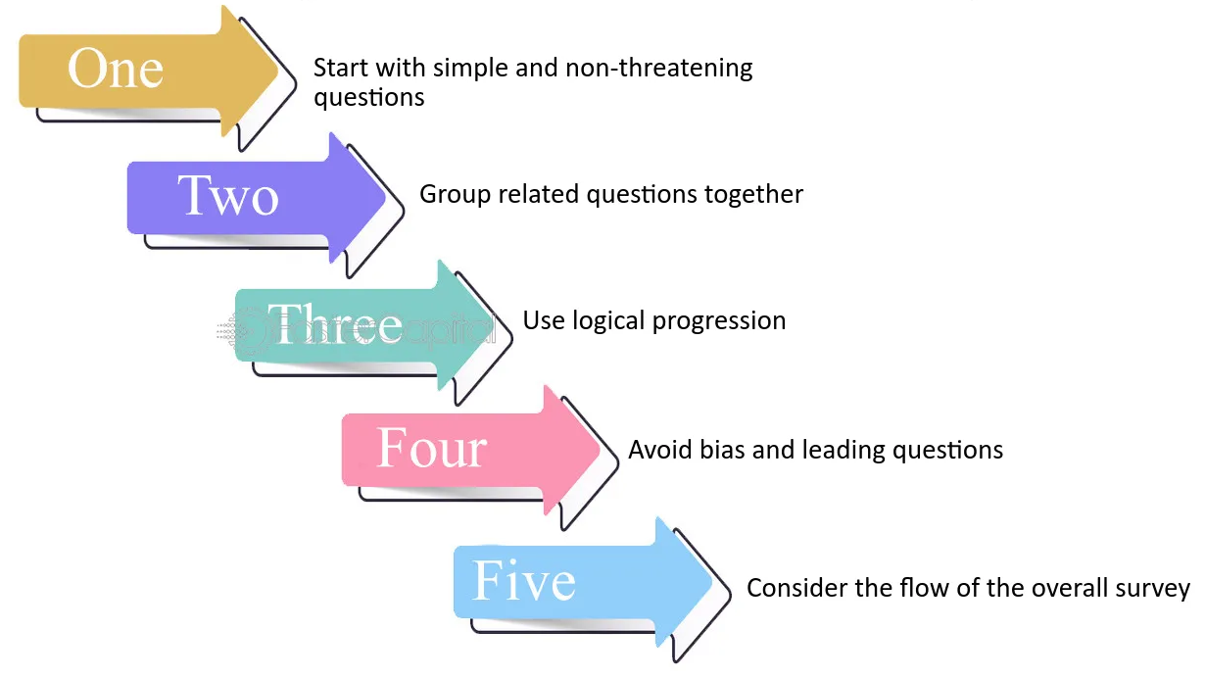
(General to Specific)

Slide 25

QUESTION FORMULATION AND WORDING
Questions must be very clear.
Questions should also be impartial.
Question should be easy to understand.
Questions must be simple & convey only one thought at a time.
Simple and familiar words must be chosen to frame questions.
Words with ambiguous meanings must be avoided.
Words with emotional connotations should be avoided.
Be Cautious in using phrases that reflect upon the prestige of the respondent.
Question wording and formulation is an art and can be learnt only by practice.

Slide 26
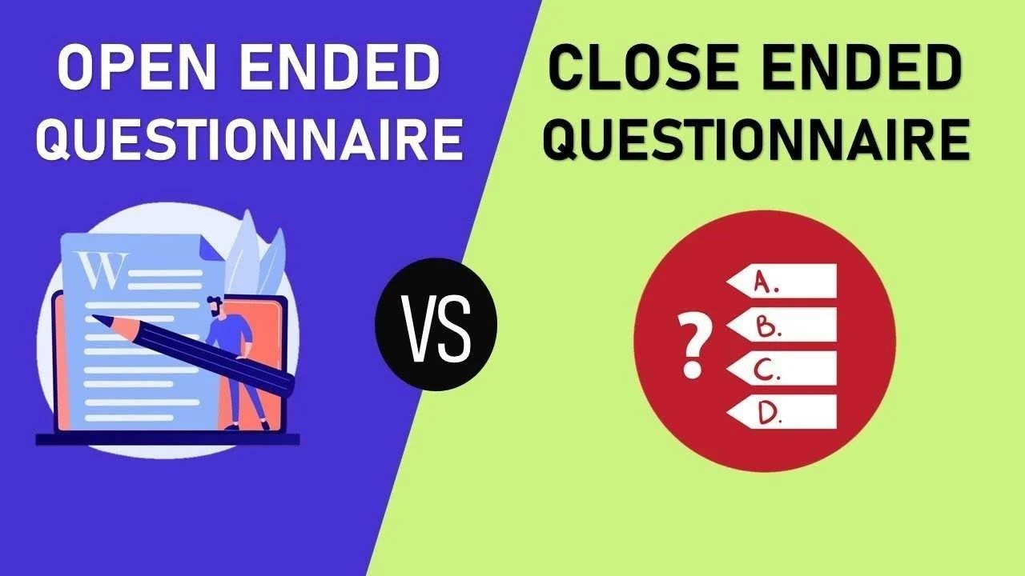
OPEN-END QUESTIONS
Respondent must answer in his own words.
Takes time to answer.
Open-ended questions are more difficult to analyze.
Appropriate for complex issues.
Respondents have an opportunity to express their opinions.
MULTIPLE CHOICE QUESTIONS
Respondent selects one of the alternative possible answers .
Closed Questions :Question with only two possible answers (‘Yes’ or ‘No’)
They can be easily handled, Simple and quick to answer
Forces an opinion on an issue about which the respondent has no opinion.

Slide 27
ESSENTIALS OF A GOOD QUESTIONNAIRE
The size of the questionnaire should be kept minimum.
Questions should proceed in logical sequence, (easy to more difficult ones).
Personal and intimate questions should be left to the end.
Technical terms and vague expressions should be avoided in a questionnaire.
Questions may be dichotomous (yes or no answers), multiple choice (alternative answers listed) or open-ended.

Slide 28
ESSENTIALS OF A GOOD QUESTIONNAIRE
There should be some control questions that ensure the reliability of the respondent.
Questions affecting the sentiments of respondents should be avoided.
Adequate space for answers should be provided in the questionnaire.
There should always be provision for indicating uncertainty. (“do not know,” “no preference”).
Brief directions about filling up the questionnaire should be given in the questionnaire.
Good physical appearance of the questionnaire.

Slide 29
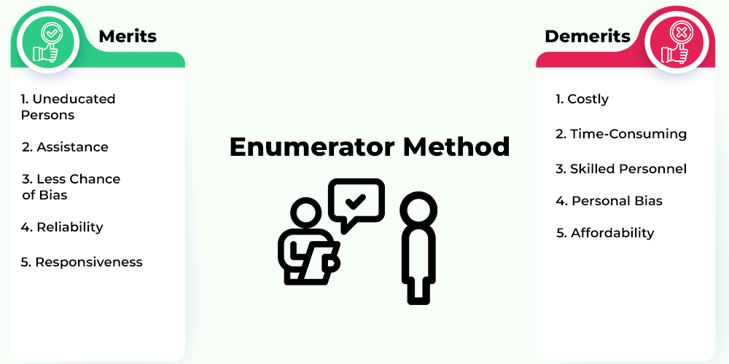
COLLECTION OF DATA THROUGH SCHEDULES
Schedules: They are proforma containing a set of questions.
Schedules are filled in by the enumerators who are specially appointed for the purpose.
The enumerators go to respondents and record the replies.
Enumerators explain the aims and objects of the investigation.
The enumerators should be trained
Enumerators be capable of cross examining the truth.
They should be honest, sincere, hardworking and should have patience.
Schedules are very useful in extensive enquiries.
Population census all over the world is conducted through this method.
Notes:
very much like the collection of data through questionnaire.

Slide 30

COLLECTION OF SECONDARY DATA
SECONDARY DATA: The data that is already available. The data which has already been collected and analyzed by someone.
SOURCES OF PUBLISHED DATA
Various publications of the central, state are local governments.
Publications of foreign governments or of international bodies.
Technical and trade journals, books, magazines and newspapers.
Reports and publications of various associations like industry, banks, stock exchanges.
Reports by research scholars, Public records, historical documents.
SOURCES OF UNPUBLISHED DATA
Diary write ups, Letters
Unpublished biographies and autobiographies
Scholars and research workers, trade associations, labor bureaus.
Public/ private individuals and organizations.

Slide 31
CHARACTERISTICS OF SECONDARY DATA
SECONDARY DATA: The data that is already available. The data which has already been collected and analyzed by someone.
RELIABILITY OF DATA
Who collected the data?
What were the sources of data?
Were they collected using proper methods, was there any bias ?
At what time were they collected?
What level of accuracy was desired? Was it achieved ?

Slide 32
CHARACTERISTICS OF SECONDARY DATA
SUITABILITY OF DATA
The data that are suitable for one enquiry may not be suitable for another enquiry, nature of original enquiry might be different.
ADEQUACY OF DATA
Data is inadequate if it does not meet the desired level of accuracy.
Data is inadequate if is related to an area which may be either narrow or wider than the area of the present enquiry.
Researcher should not use secondary data without proper validation.
Notes:
Definition of various terms, units of collection The researcher must scrutinize the used primarily during data collection.
If the available data are found to be unsuitable, they should not be used by the researcher.
If the researcher finds differences in these, the data will remain unsuitable for the present .
Researcher should not ignore data if they are readily available from authentic sources.

Slide 33

DATA
INTERPRETATION
AND
REPORT WRITING

Slide 34
INTERPRETATION OF DATA
Interpretation refers to the task of drawing inferences from the collected facts after an analytical or experimental study.
Interpretation is concerned with relationships within the collected data.
Need to be done carefully, to avoid misleading conclusions.
The task of interpretation has two major aspects
Establish continuity in research by linking the results to other studies.
Establishment of some explanatory concepts.
Notes:
If hypotheses are tested and upheld several times, the researcher may arrive at generalizations.
If the researcher has no hypothesis to start with, he will try to explain his findings based on some theory.

Slide 35
WHY INTERPRETATION?
The usefulness and utility of research findings lie in proper interpretation.
Interpretation gives the researcher a good understanding of the abstract principle that works beneath the findings.
If hypotheses are tested and upheld several times, the researcher may arrive at generalizations that leads to establishment of explanatory concepts .
If the researcher has no hypothesis to start with, he will try to explain the findings based on some theory. (as in Exploratory study )

Slide 36
TECHNIQUE OF INTERPRETATION
Interpretation is an art that one learns through practice and experience.
The steps in interpretation:
Researcher must give reasonable explanations for the relations derived.
Additional information, collected during the study, must be considered.
Before the final interpretation it is advisable to consult someone having insight into the study.
The person need to be frank and honest enough to point out omissions and errors.
Must consider all relevant factors affecting the problem to avoid false generalization. (Never hurry)

Slide 37


Slide 38

STEPS IN WRITING REPORT
The usual steps involved in writing report are:
Logical analysis of the subject-matter
Preparation of the final outline
Preparation of the rough draft
Rewriting and polishing
Preparation of the final bibliography
Writing the final draft

Slide 39
1. LOGICAL ANALYSIS OF THE SUBJECT-MATTER
Logical analysis is concerned with the development of a subject logically or chronologically.
Logical Development: The logical development is made based on mental connections and associations between the one thing and another by means of analysis.
Chronological Development: It is based on a connection or sequence in time or occurrence.
2. PREPARATION OF THE FINAL OUTLINE
Outlines are the framework upon which long written works are constructed.
They are an aid to the logical organization of the material.
They act as a reminder of the points to be stressed in the report.

Slide 40
3. PREPARATION OF THE ROUGH DRAFT
The researcher roughly writes down what he has done in the context of his research study.
He will write down the procedure adopted by him for
Sampling
Data collection.
Techniques for Data Analysis.
Limitations faced by the researcher.
Broad findings and generalizations with respect to the study.
Various suggestions he wants to offer regarding the problem concerned.

Slide 41
4. REWRITING AND POLISHING
This is the most difficult part of all formal writing and requires more time.
Check the report for weaknesses in the presentation.
He should check the mechanics of writing—grammar, spelling and usage.
5. PREPARATION OF THE FINAL BIBLIOGRAPHY
Bibliography is a list of books or works referenced by the researcher.
The bibliography should be arranged alphabetically.
Part1 : Names of books and pamphlets.
Part 2 : Names of magazine and newspaper articles.

Slide 42
BIBLIOGRAPHY ENTRY FORMAT
The bibliography entries can have more than one acceptable form, but importantly it must remain consistent.
FOR BOOKS AND PAMPHLETS | FOR MAGAZINES AND NEWSPAPERS
Name of author, last name first. Title of book, indicate italics. Place, publisher Date of publication. Number of volumes. | Name of the author, last name first. Title of article, in quotation marks. Name of periodical. The volume number. The date of the issue. The pagination.
Example Kothari, C.R., Quantitative Techniques, New Delhi, Vikas Publishing House Pvt. Ltd., 1978. | Example Robert V. Roosa, “Coping with Short-term International Money Flows”, The Banker, London, September 1971, p. 995

Slide 43
6. WRITING THE FINAL DRAFT
The final draft is the most effective in communicating the research findings to others.
It should be written in concise and objective style and in simple language.
The report should avoid vague expressions such as “it seems”, “there may be” etc.
The researcher must avoid abstract terminology (hard to understand).
A research report should not be dull, It needs to maintain interest for the reader.
The report must have originality.

Slide 44
LAYOUT OF THE RESEARCH REPORT
1. PRELIMINARY PAGES
Title and date
Acknowledgements.
Table of contents (Index)
List of tables and illustrations.
2. MAIN TEXT
It provides the complete outline of the research report. Each main section of the report should begin on a new page.
Introduction
Statement of findings and recommendations.
The results.
The implications drawn from the results
The summary.
3. THE CONCLUSION (END)
Appendices of all technical or additional data.
Bibliography of sources consulted.
Notes:
The value of index lies in the fact that it

Slide 45
SECTIONS OF MAIN TEXT
1. INTRODUCTION
It Introduces the research project to the readers.
It should contain a clear statement of the objectives of research.
The hypotheses of study, if any.
The definitions of the major concepts employed in the study.
The methodology adopted in conducting the study.
The scope of the study.
Should narrate the various limitations, under which the research project was completed.
Notes:
Methodology
How was the study carried out?
What was its basic design?
what were the experimental manipulations?
Regarding the sample used in the study, Who were the subjects?
How many were there?
How were they selected?
The statistical analysis adopted.

Slide 46
SECTIONS OF MAIN TEXT
2. STATEMENT OF FINDINGS AND RECOMMENDATIONS
The statement of findings and recommendations must be stated in a non-technical and summarized manner so that it can be easily understood by all.
3. RESULTS
Presentation of the findings of the study, (supporting data as tables and charts.
Should contain statistical summaries.
Results should be presented in a logical sequence.
Should include all relevant results.
Clearly state the problem concerned and how he worked on it.
The conclusions from the study, and the reasoning behind the conclusions.

Slide 47
SECTIONS OF MAIN TEXT
4. IMPLICATIONS OF THE RESULTS
The conclusion drawn should be related to the hypotheses stated.
Inferences drawn from the present study may apply in similar circumstances.
The conditions of the present study may limit the extent of legitimate generalizations of the inferences.
The relevant questions that remain unanswered or new questions raised by the study with suggestions on the kind of research that may apply.
5. SUMMARY
The researcher should conclude the research report with a summary. The summary extracts and highlights the most important points from a larger body of work.

Slide 48
TYPES OF REPORTS
Research reports vary greatly in length and type.
Business firms: Reports in the letter form, just one or two pages in length.
Financial institutions: Short balance-sheet type of tabulation for their annual reports
Mathematicians: Present the results in algebraic notations.
Chemists: Present the results in symbols and formulae.
Students of literature: long reports presenting the critical analysis of some writer.
Clinical psychologists: case-history form.
News items in the daily papers are also forms of report writing.
Book-reviews: Analyze the content of the book and report on the authors intentions, his language, his style etc.
Ph.D. theses report-writing, usually done by students in academic institutions.

Slide 49
TECHNICAL VS POPULAR REPORT
TECHNICAL REPORT
It describes the process, progress, or results of scientific research.
It emphasizes on the assumptions made during study.
It also include recommendations and conclusions of the research.
It is very lengthy with multiple identifiable sections.
POPULAR REPORT BUSINESS REPORT
An approach of presenting financial and non-financial information to non-professional users (e.g., citizens) in a concise, and easy-to-read format.
Aims at simplicity and attractiveness and policy implications.
Involves minimal of technical details, and liberal use of charts and diagrams.
Attractive layout along with large prints, many subheadings, even an occasional cartoon.

Slide 50
TECHNICAL REPORT
OUTLINE OF A TECHNICAL REPORT
Summary of results: Review of the main findings.
Nature of the study: General objectives of study, formulation of the problem in operational terms, the working hypothesis, the type of analysis and data required, etc.
Methods employed: Specific methods used in the study and their limitations.
Data: Data collected, their sources, methods employed, characteristics and limitations.
Analysis of data and presentation of findings: Presentation of the findings in the form of tables and charts. (Main Body)
Conclusions: A detailed summary of the findings and the implications drawn from the results.
Bibliography: Bibliography of various sources consulted.
Technical appendices: Additional information on all the technical matters.
Index: Index must be prepared and be given invariably in the report at the end.
Notes:
OUTLINE OF A TECHNICAL REPORT
Summary of results: Review of the main findings.
Nature of the study: General objectives of study, formulation of the problem in operational terms, the working hypothesis, the type of analysis and data required, etc.
Methods employed: Specific methods used in the study and their limitations.
Data: Data collected, their sources, methods employed, characteristics and limitations.
Analysis of data and presentation of findings: Presentation of the findings in the form of tables and charts. (Main Body)
Conclusions: A detailed summary of the findings and the implications drawn from the results.
Bibliography: Bibliography of various sources consulted.
Technical appendices: Additional information on all the technical matters.
Index: Index must be prepared and be given invariably in the report at the end.
Methods employed: Specific methods used in the study and their limitations. For instance, in sampling studies we should give details of sample design viz., sample size, sample selection.

Slide 51
POPULAR REPORT
OUTLINE OF A POPULAR REPORT
The findings and their implications: Emphasis in the report is given on the findings of most practical interest.
Recommendations for action: Recommendations for action based on the findings of the study.
Objectives of the study: A general review of the objectives of the project under study.
Methods employed: Non-technical description of the methods used.
Results: The results are presented in clear and non-technical terms with liberal use of all sorts of illustrations such as charts, diagrams etc.
Technical appendices: More detailed information on methods used, forms.

Slide 52
MECHANICS OF WRITING A RESEARCH REPORT
1. SIZE AND PHYSICAL DESIGN
The manuscript should be written on unruled paper 812″ × 11″ in size.
If written by hand
Use black or blue-black ink should be used.
A margin of at least 1.5 inch on left, and 0.5 inch on right hand side of paper.
There should also be one-inch margins, top and bottom.
The paper should be neat and legible.
If typed, all typing should be double-spaced.

Slide 53
MECHANICS OF WRITING A RESEARCH REPORT
2. PROCEDURE
Various steps in writing the report should be strictly adhered.
3. LAYOUT
Layout of the report should be thought of and decided and accordingly adopted based on the objective.
4. TREATMENT OF QUOTATIONS
Quotations should be placed in quotation marks and double spaced.
If of considerable length, then it should be single-spaced and indented at least 0.5” to the right of the normal text margin.

Slide 54
MECHANICS OF WRITING A RESEARCH REPORT
5. THE FOOTNOTES
Footnotes are notes placed at the bottom of the page in a piece of academic writing and indicated in the text with superscript numbers.
These notes serve as references to cited works and offer supplementary information to aid the reader’s understanding.
Footnotes should be numbered consecutively, usually beginning with 1 in each chapter separately.
Footnotes are always typed in single space though they are divided from one another by double space.

Slide 55
MECHANICS OF WRITING RESEARCH REPORT
Reference Format
Author’s name in normal order
Title of work, underlined to indicate italics.
Place and date of publication.
Number of volume (multivolume reference )
Pagination references.
Regarding periodicals reference
Name of the author in normal order.
Title of article, in quotation marks.
Name of periodical, underlined to indicate italics.
Volume number
Date of issuance
Pagination.

Slide 56
Second-hand quotations
Original author and title “quoted or cited in,”
Second author and work
Case of multiple authorship
Name of first author is given and the others are indicated by “et al.” or “and others”.
A single page should be referred to as p.
More than one page be referred to as pp.
If Several pages referred to at a stretch eg: pp. 190ff, (190 and following pgs).
If only for page 190 and the following page ‘190f’.
Roman numerical is generally used to indicate the number of the volume of a book.

Slide 57
COMMON ABBREVIATIONS IN REPORT-WRITING
anon., anonymous
ante., before
art., article
aug., augmented
bk., book
bull., bulletin
cf., compare
ch., chapter
col., column
diss., dissertation
ed., editor, edition, edited.
ed. cit., edition cited
e.g. for example
eng., enlarged
et.al., and other
et seq. and the following
ex., example
f., ff., and the following
fig(s).,figure(s)
fn., footnote
ibid., in the same place
illust(s). illustrated, illustration(s)
Intro., intro., introduction
N.B., nota bene: note well
n.d., no date
n.p., no place
no pub., no publisher
no(s)., number(s)
o.p., out of print
p. or pp., page(s)
passim: here and there
post: after
rev., revised
tr., trans., translator, translated, translation
vid or vide: see, refer to
viz., namely
vol. or vol(s)., volume(s)
vs., versus: against

Slide 58
6. USE OF STATISTICS, CHARTS AND GRAPHS
The use of statistics in research reports contributes towards the clarification and simplification of the research results.
Statistics are usually presented in the form of tables, charts, bars and line-graphs and pictograms.
Statistics , charts and graphs should be self explanatory.
Statistical presentations should be neat and attractive.
7. THE FINAL DRAFT
Rewriting the rough draft of the report should be done with great care.
Are the sentences written in the report clear?
Are they grammatically, correct?
Do they say what is meant’?
Do the various points incorporated in the report fit together logically?
Sentences that seem clear to the writer may prove quite confusing to others.

Slide 59
8. BIBLIOGRAPHY
Bibliography should be prepared and appended to the research report.
9. PREPARATION OF THE INDEX
Index, acts as a good guide, to the reader.
Index may be prepared both as subject index and as author index.
SUBJECT INDEX gives the names of the subject-topics or concepts along with the number of pages on which they have appeared or discussed in the report.
AUTHOR INDEX gives the similar information regarding the names of authors.
The index should always be arranged alphabetically.

